Slide 1
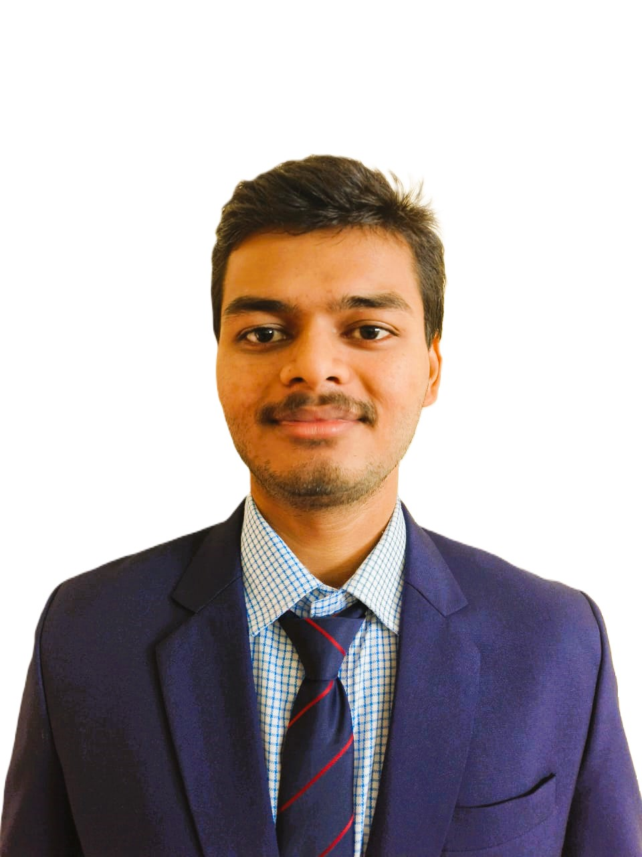
CAPSTONE PROJECT IPL SCORE PREDICTION
Presented By
Student Name: Rohit kumar
College Name: Gandhi Engineering College
Department: Computer Science
Email ID: rohitkumar270206@gmail.com
AICTE Student ID:AINSI_127562

Slide 2
OUTLINE
Problem Statement
Proposed System/Solution
System Development Approach
Algorithm & Deployment
Result (Output Image)
Conclusion
Future Scope
References

Slide 3
Problem Statement
In the dynamic and fast-paced world of cricket, every run and tactical decision holds the power to shift the outcome of a match. The ability to predict IPL scores in real time using Deep Learning has emerged as a transformative approach. This project explores how advanced machine learning algorithms can forecast match scores with high accuracy, offering valuable insights to fans, analysts, and teams during live games.

Slide 4
Proposed Solution
Gather historical IPL match data including over-wise scores, team compositions, player stats, venues, and match outcomes.
The proposed system aims to tackle the challenge of predicting IPL match scores in real time by leveraging Deep Learning and advanced data analytics techniques. This solution seeks to deliver accurate score forecasts, enhancing fan engagement and assisting analysts and teams with tactical insights.
Data Collection
Gather historical IPL match data including over-wise scores, team composition, player stats, venues and match outcomes.
Data Preprocessing
Clean and preprocess the collected data to address missing values, outliers, and inconsistences.
Machine Learning Algorithm
Use LSTM via Keras for score prediction trends using Seaborn & Matplotlib.
These algorithms learn from how players and teams have performed against each other in the past. Unlike simpler machine learning methods, deep learning can analyze many different factors at once making its score forecasts more reliable and closer to reality.
Deployment
Real-time dashboard using Flask or Streamlit ;hosted on cloud platform.

Slide 5
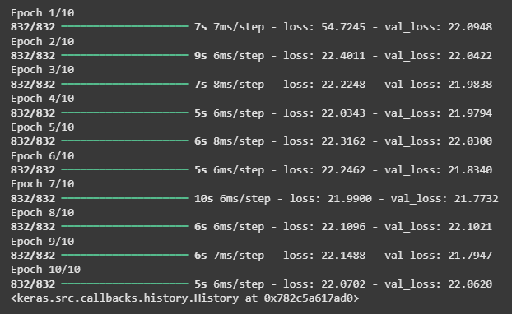
Proposed Solution
Gather historical IPL match data including over-wise scores, team compositions, player stats, venues, and match outcomes.
5. Evaluation
Evaluate model performance using MAE.
Monitor prediction accuracy across different match scenarios and teams.
Use feedback loops to retrain and fine-tune the model for better performance in future matches.
Training the model

Slide 6
System Approach
This project leverages a modular and structured approach for IPL score prediction, implemented using Jupyter Notebook and key Python libraries. The workflow is organized into distinct stages:

Slide 7
Algorithm & Deployment
Algorithm Selection:
keras.Sequential() creates a stack of layers.
Dense layers are fully connected layers.
activation=relu adds non-linearity.
Output layer uses linear activation because it’s regression.
Huber loss combines MSE and MAE advantages to handle outliers better.
adam optimizer adjusts weights efficiently.
Data Input:
We build an interactive interface using ipywidgets so users can select match details and get a live predicted score.
Training Process:
I train the model on the scaled training data for 10 epochs with a batch size of 64, validating on the test set.
Prediction Process
We predict scores on test data and evaluate model performance using mean absolute error (MAE)..

Slide 8
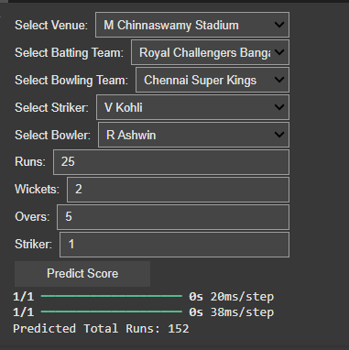
Result

Slide 9
Conclusion
This project demonstrates the potential of Deep Learning to revolutionize live sports analytics by predicting IPL scores with impressive accuracy. Through meticulous data preprocessing, advanced modeling techniques using LSTM and Scikit-learn, and real-time deployment, the system showcases how technology can enhance fan engagement, support strategic decision-making, and uncover insights previously hidden in match data. The success of this approach opens doors to broader applications in sports forecasting and real-time performance analysis.

Slide 10
Future scope
- Expand prediction to other cricket formats and leagues
- Forecast individual player performance metrics
- Develop strategic tools for coaches and analysts
- Create fan-focused platforms like fantasy advisors
- Explore AR/Voice interfaces for live match interaction

Slide 11
References
1.Numpy Documentation
2.Pandas Documentation
3.Matplotlib Documentation
4.Seaborn Documentation
5.Scikit-learn Documentation
6.Keras Documentation

Slide 12
Thank you

